Slide 1

Notes:
Good morning, everyone. Today, we’re discussing the overarching economic shift defining our current decade: Market Sovereignty and the battle between free markets and regulatory capture.
https://www.youtube.com/watch?v=wcV0SRPFK9s

Slide 2
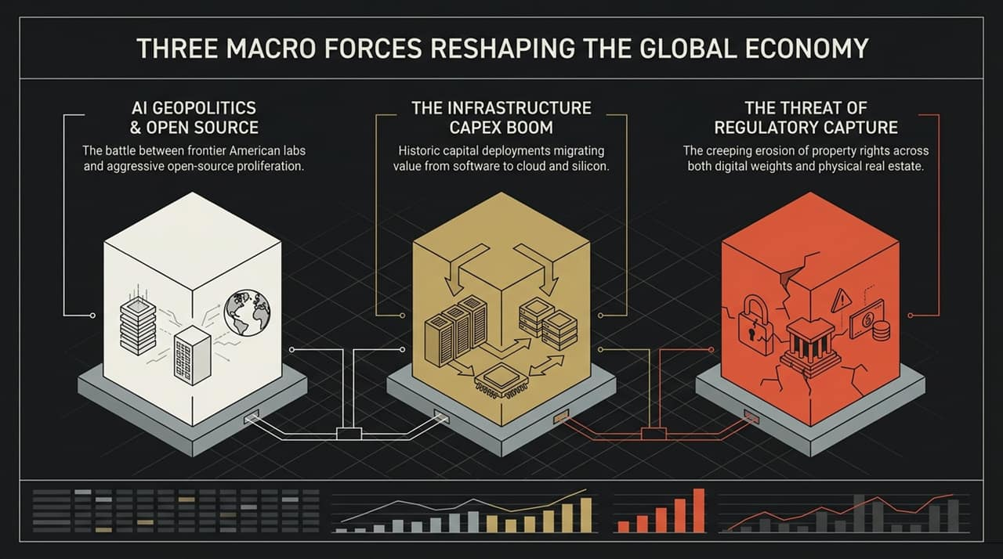
Notes:
When we look at the modern technological and real-world landscape, three powerful macro forces are simultaneously reshaping global capital allocation:
AI Geopolitics & Open Source: The intense battle between frontier closed-source American labs and rapid, aggressive open-source proliferation.
The Infrastructure CapEx Boom: Historic capital deployments moving hundreds of billions of dollars from traditional software margins into hard cloud infrastructure, energy, and silicon.
The Threat of Regulatory Capture: A creeping erosion of property rights across both digital assets—like model weights—and physical assets like real estate.
Over the next few slides, we will unpack how digital weights and physical bricks share the exact same underlying economic incentives, and why defending open markets across both is crucial.

Slide 3
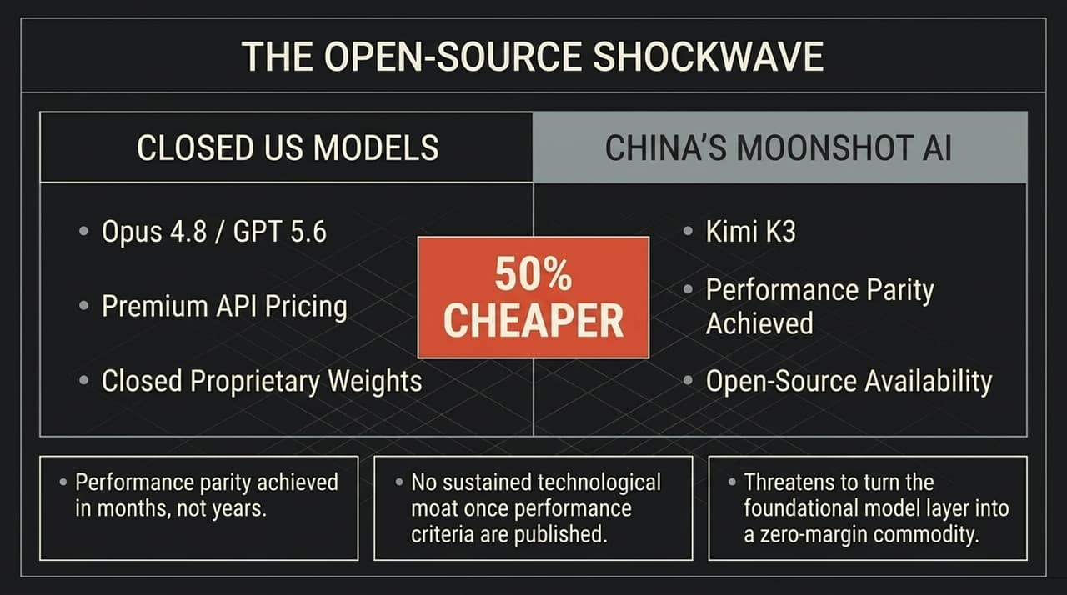
Notes:
Let's dive into the core conflict in artificial intelligence today: Closed US Frontier Models vs. Global Open-Source Competitors.
On one side, you have closed American labs offering frontier models behind premium API pricing walls. On the other side, open-weight models—such as China’s Moonshot AI (Kimi K3)—are achieving performance parity with top-tier US models like Claude Opus 4.8 and GPT-5.6 at 50% of the cost.
Here is the critical strategic takeaway: performance parity is now being achieved in months, not years. Once a closed lab publishes benchmark performance, open-source researchers replicate and optimize it rapidly. There is no sustained technological moat at the foundational model layer. Open source threatens to turn base models into a zero-margin commodity.

Slide 4
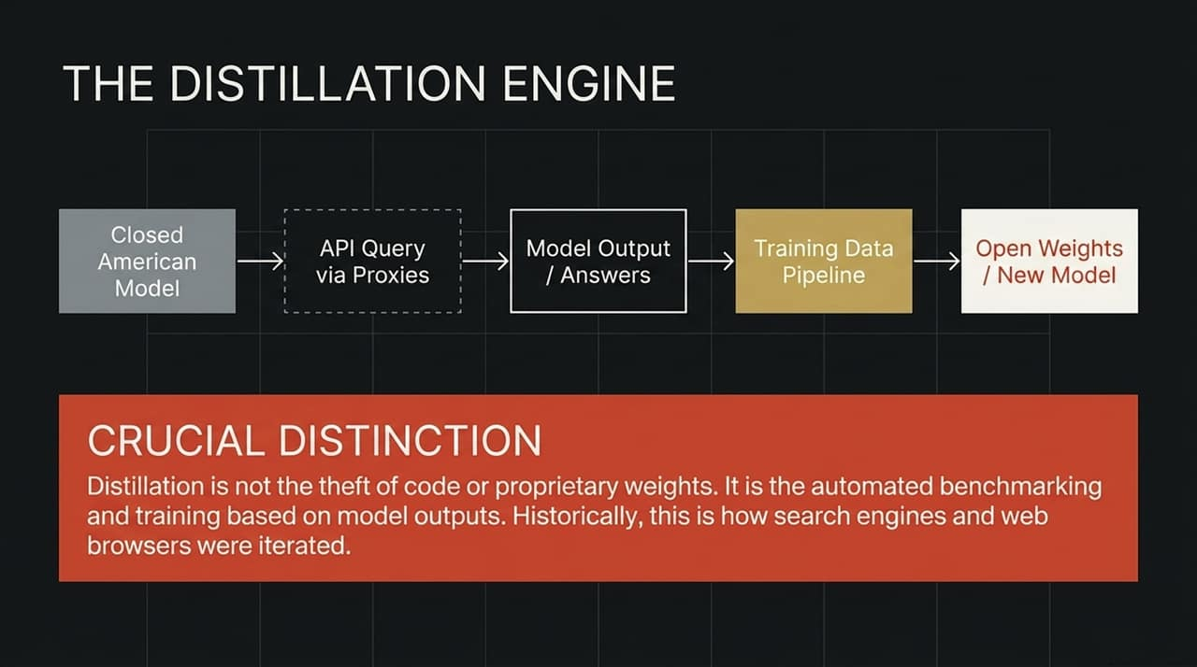
Notes:
How is open source catching up so fast? Through a process called Distillation.
As shown in this diagram, a query is sent to a closed model API via proxies. The model's answers and reasoning outputs are collected and fed into a synthetic data pipeline to train a new, highly efficient open-weight model.
We must make a crucial distinction here: Distillation is not the theft of underlying code or proprietary model weights. It is automated benchmarking and learning based on public API outputs. Historically, this is the exact mechanism by which search engine indexing, web browsers, and open-source software were iterated and improved upon.

Slide 5
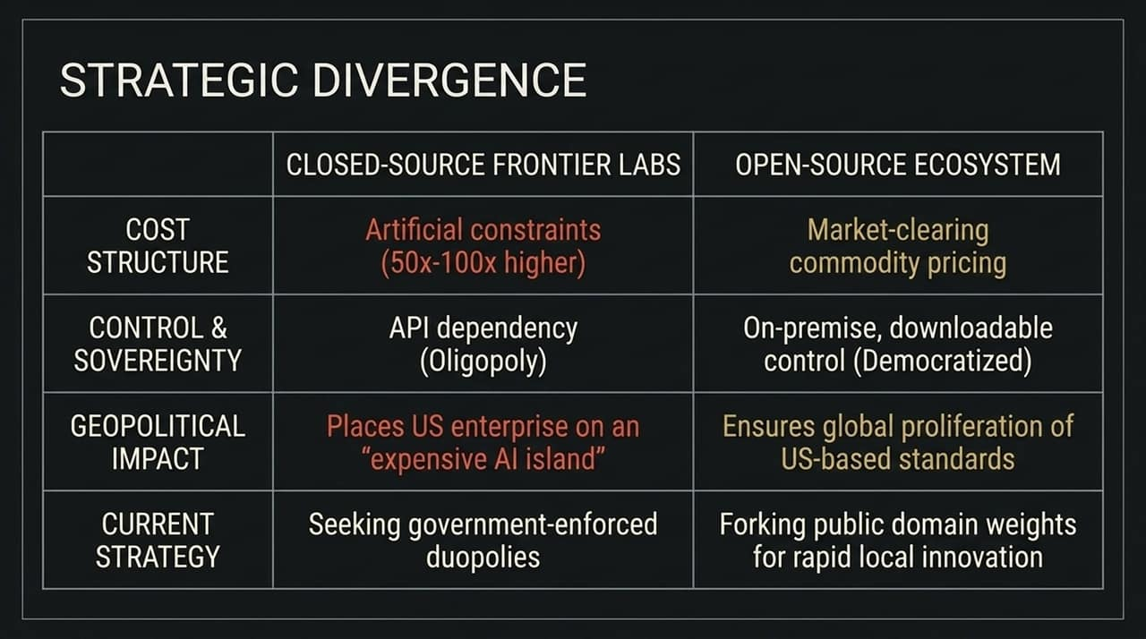
Notes:
This brings us to a fundamental strategic divergence between two paradigms: Closed-Source Frontier Labs vs. The Open-Source Ecosystem.
Cost Structure: Closed models enforce artificial price constraints—often 50x to 100x more expensive per token—while open source clears at market commodity pricing.
Control & Sovereignty: Closed APIs create oligopolistic dependencies. Open source provides downloadable, on-premise control that democratizes intelligence.
Geopolitical Impact: Mandating high-cost API dependencies puts US enterprises on an 'expensive AI island' relative to global competitors. Proliferating open-source ensures global standards remain rooted in US-developed architecture.
Current Strategy: Closed labs are seeking government-enforced duopolies to protect margins, while open-source developers fork public domain weights for rapid local innovation.

Slide 6
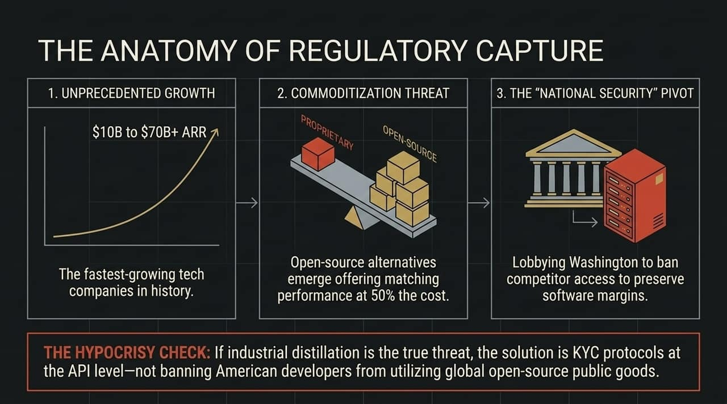
Notes:
When closed software companies face commoditization, they follow a classic three-step playbook for Regulatory Capture:
Unprecedented Growth: Companies scale at record speed, growing from $10 Billion to over $70 Billion in ARR.
Commoditization Threat: Open-source alternatives emerge offering 95%+ performance parity at half the cost, threatening to compress software margins to zero.
The 'National Security' Pivot: Unable to stop open source through market competition, incumbent labs lobby Washington to regulate or ban open-weight competitors under the guise of national security.
Hypocrisy Check: If industrial distillation or data extraction across borders is the genuine concern, the appropriate policy is standard Know-Your-Customer (KYC) protocols at the API level—not banning American developers from leveraging open-source software.

Slide 7
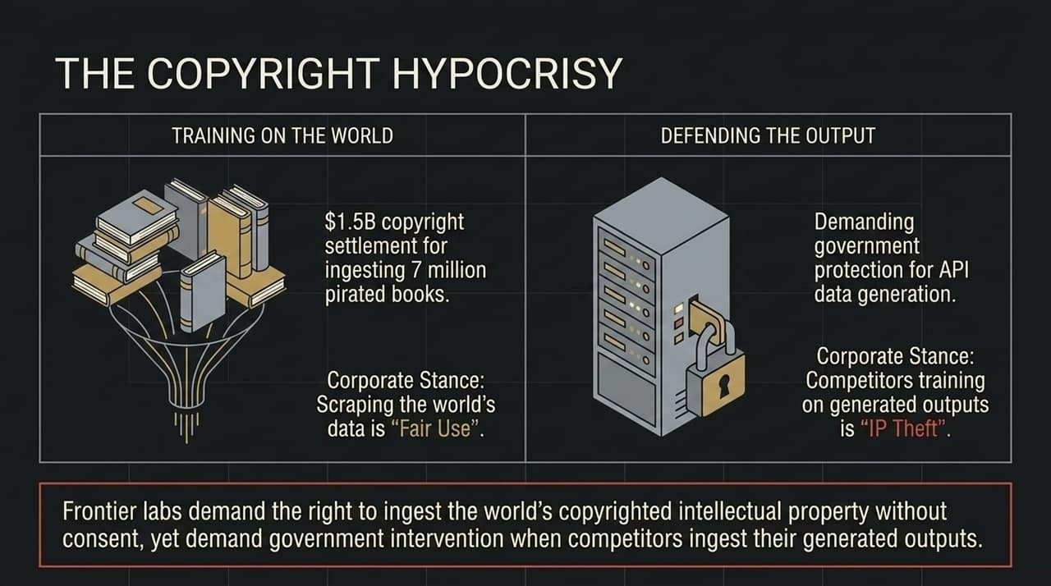
Notes:
There is a glaring double standard in how frontier labs treat IP:
When training their models on the world’s data—such as ingesting millions of books, web pages, and media—labs maintain the legal stance that web scraping is protected 'Fair Use'.
However, the moment competitors train on the text or code generated by their APIs, these same labs claim that API output distillation constitutes 'IP Theft' and demand government intervention.
Simply put: Frontier labs demand the right to ingest the world's copyrighted intellectual property without consent, but run to regulators when competitors ingest their generated outputs.

Slide 8
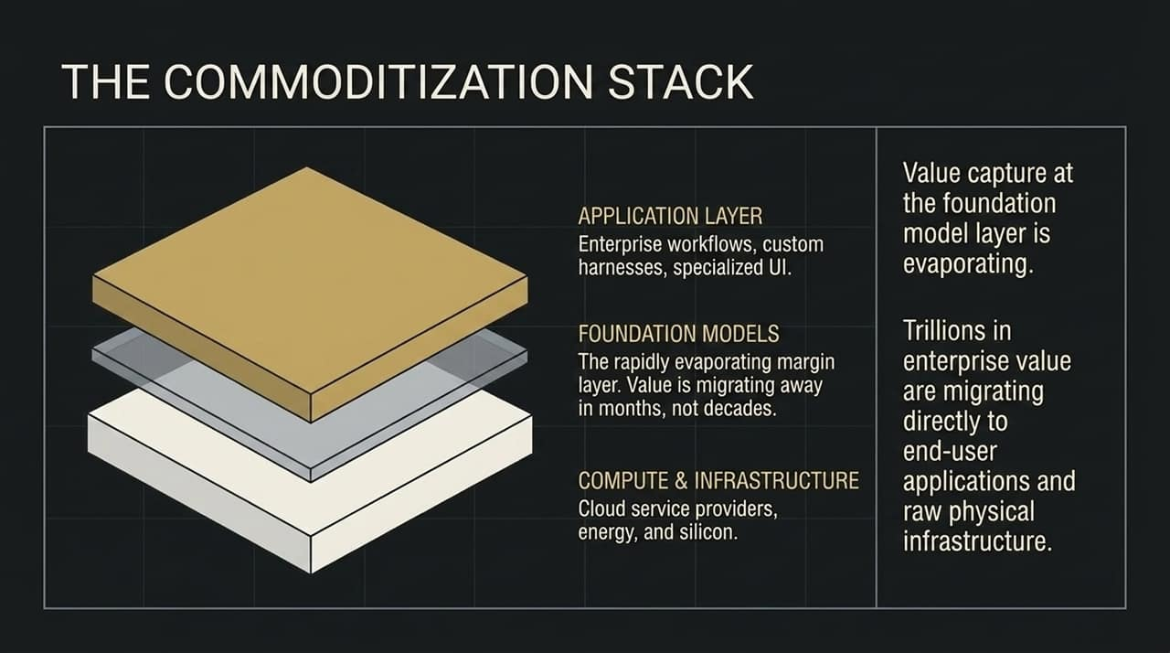
Notes:
To understand where value resides in the AI era, look at The Commoditization Stack:
Application Layer (Top): Enterprise workflows, specialized UI, and custom harnesses. Value captures here because end-users pay for solutions.
Foundation Models (Middle): The rapidly evaporating margin layer. As model capabilities equalize, price per token approaches zero.
Compute & Infrastructure (Bottom): Cloud service providers, energy, and silicon.
Trillions of dollars in enterprise value are migrating away from the middle model layer and shifting directly into end-user applications and raw physical infrastructure.

Slide 9
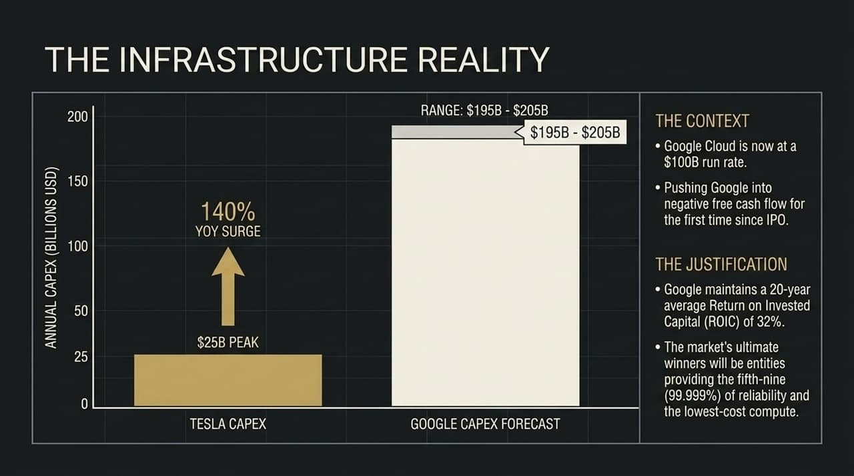
Notes:
Because value is shifting to infrastructure, capital expenditure numbers are reaching historical extremes.
To put this in perspective: Tesla's peak annual CapEx was roughly $25 Billion during its massive factory buildout phase. Today, Google’s annual CapEx forecast is reaching $195 Billion to $205 Billion—a massive 140% year-over-year surge.
This CapEx burn is so severe it pushed Google into negative free cash flow for the first time since its IPO, despite Google Cloud reaching a $100 Billion run rate. Why do it? Because with a 20-year average ROIC of 32%, hyperscalers know that the ultimate winners will be those who control the lowest-cost compute with five-nines (99.999%) uptime reliability.

Slide 10
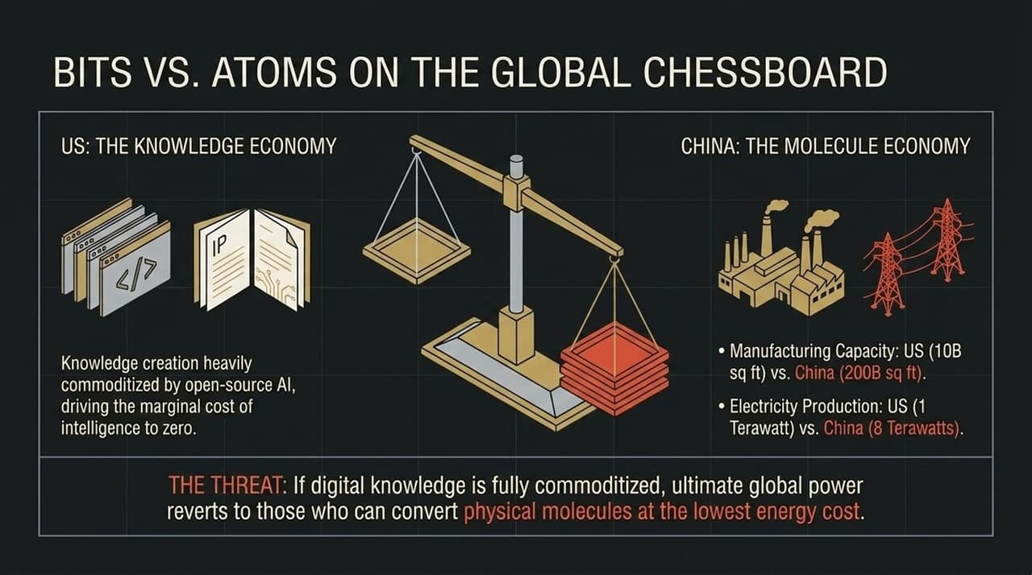
Notes:
This brings us to a geopolitical reality: Bits vs. Atoms.
The United States dominates the Knowledge Economy (IP, software, digital weights). China dominates the Molecule Economy (manufacturing, energy production, physical infrastructure).
Look at the metrics:
Manufacturing Capacity: US has ~10 billion sq ft vs. China’s 200 billion sq ft.
Electricity Production: US sits at ~1 Terawatt vs. China’s 8 Terawatts.
The Strategic Risk: As open-source AI drives the marginal cost of software and digital intelligence down to zero, economic power reverts back to whoever can process physical molecules at the lowest energy cost."

Slide 11
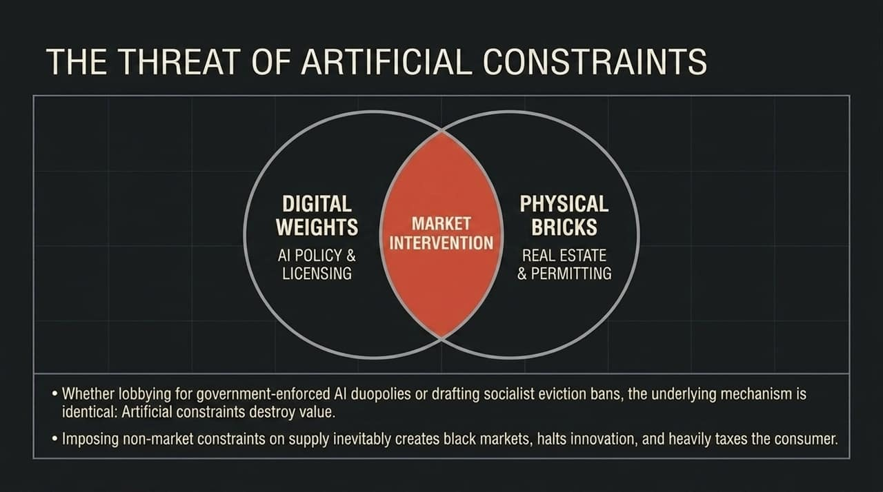
Notes:
Now let’s bridge digital policy to physical assets. The intersection of Digital Weights (AI policy) and Physical Bricks (Real Estate) is governed by the same mechanism: Market Intervention and Artificial Constraints.
Whether talking about tech incumbents lobbying for AI licensing regimes or municipal governments enforcing housing restrictions, the result is identical: non-market constraints on supply destroy economic value, create black markets, stifle innovation, and penalize consumers.

Slide 12
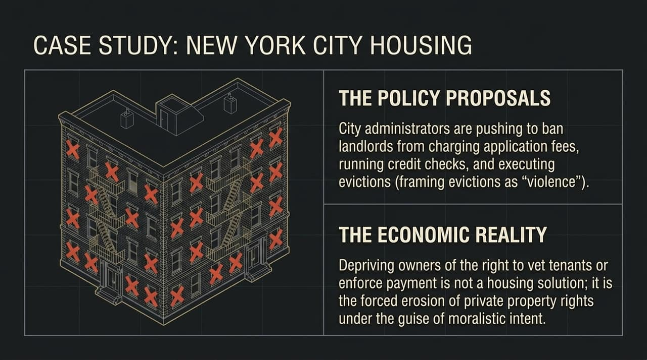
Notes:
Let's look at a concrete case study in physical market intervention: New York City Housing.
City administrators continue to push policies banning landlords from charging application fees, running standard credit checks, or executing evictions.
While framed as moral interventions, depriving property owners of the right to vet tenants or enforce contractual payments is a direct erosion of private property rights that yields severe economic unintended consequences.

Slide 13
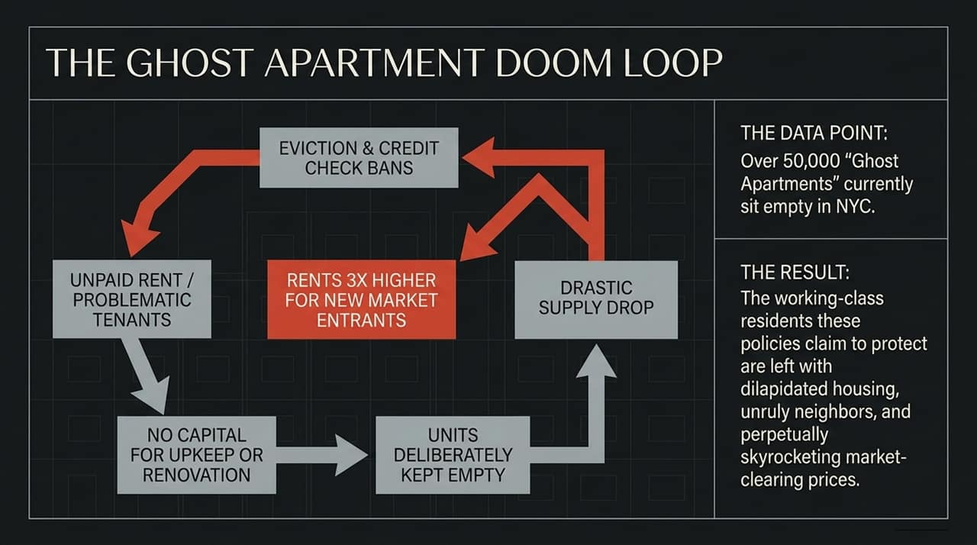
Notes:
Here is how regulatory intervention creates a self-reinforcing market failure—the Ghost Apartment Doom Loop:
Eviction and credit check bans lead to uncollectible rent and problematic tenancies.
Property owners lose capital needed for maintenance, upkeep, or renovations.
Rather than taking on unvetted risk, owners deliberately keep units empty.
Housing supply drops drastically.
Reduced supply forces market rents 3x higher for new entrants.
The Result: Over 50,000 'Ghost Apartments' currently sit empty in NYC. The very policies designed to protect working-class residents leave them with dilapidated housing and skyrocketing prices.

Slide 14

Notes:
To quote John Quincy Adams from 1787: 'The moment the idea is admitted into society that property is not as sacred as the laws of God... anarchy and tyranny commence.'
The Modern Translation: Whether we are discussing open-source software model weights or urban apartment buildings, the moralistic justification for seizing, capping, or restricting private property always precedes market failure and central economic control.
To maintain long-term economic growth, we must reject artificial constraints and allow markets to clear:
The Digital Engine: Aggressively proliferate open-source AI to democratize intelligence, spur enterprise innovation, and secure national technological sovereignty.
The Physical Engine: Deregulate physical permitting and land-use restrictions to drastically increase housing and infrastructure supply.
The cure for scarcity is never government restriction—it is always abundant supply.

Slide 15
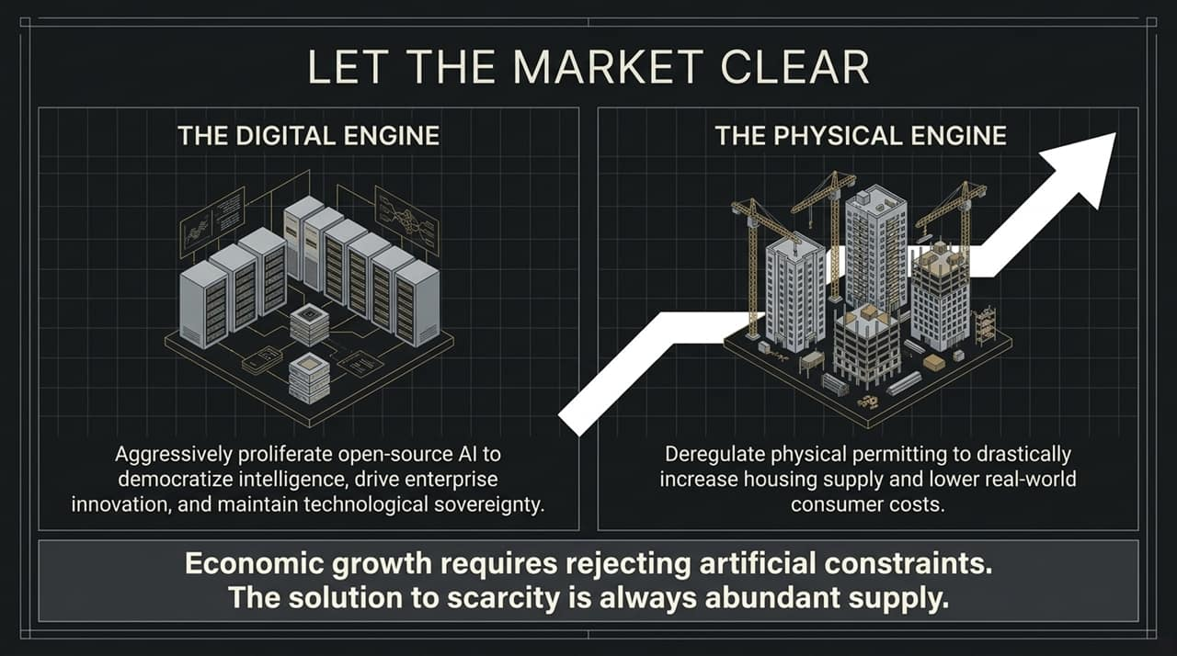
Notes:
To synthesize our discussion on AI sovereignty:
Open-Source Ecosystem: Learning through distillation is not theft. Open weight proliferation protects developers from paying a 'token tax'.
Regulatory Playbook: Closed labs with massive ARR projections ($10B to $100B+) are calling 'foul' and citing national security to lobby for government-enforced duopolies.
Value Migration: Long-term profits accrue at the Hardware and Application layers, while base foundation models commoditize rapidly.

Slide 16
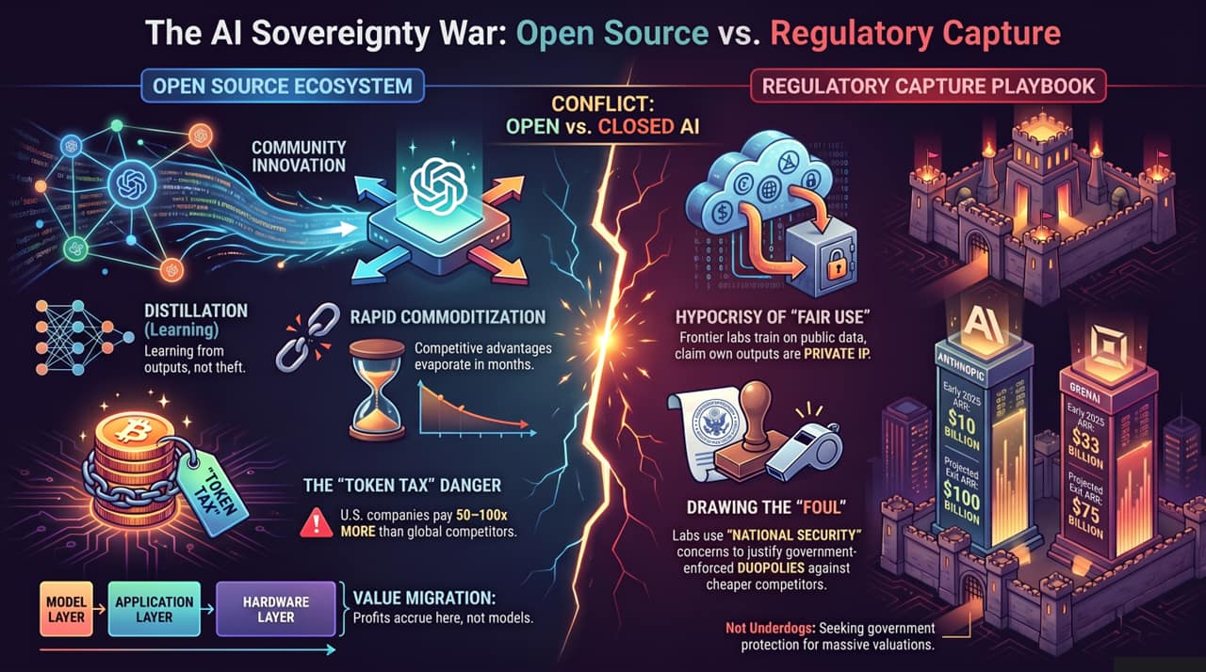
Notes:
In conclusion, whether managing digital assets or physical real estate, the blueprint for prosperity remains unchanged: enforce property rights, encourage open competition, allow capital to flow where it is most efficient, and let the market clear. Thank you, and I’m happy to take any questions

